Slide 1




ANALYSIS OF COFFEE SALES TRENDS, CUSTOMER LOYALTY, AND DISCOUNT IMPACT
BDM CAPSTONE PROJECT PRESENTATION
NAME: SUDHANSHU PRABHAT
ROLL NUMBER: 23F1001796
EMAIL: ds23f1001796@ds.study.iitm.ac.in
Indian Institute of Technology Madras
Chennai Tamil Nadu, India, 600036

Slide 2


  ORGANISATION BACKGROUND
QahwaCo is a coffee company in Saudi Arabia, they have been providing specialty coffee to their customers since 2020. Their varieties include some of the most desired origins such as Brazil, Ethiopia, Colombia, Costa Rica and Guatemala.
  ORGANISATION PROBLEMS
QahwaCo struggles to keep up with rapidly changing coffee trends and customer preferences, making inventory planning and understanding the impact of discounts difficult despite growing market demand.
01

Slide 3



  PROBLEM STATEMENTS
Analysing trends in coffee sales to aid QahwaCo in making data-driven inventory decisions and forecasting.
Exploring the influence of discounts on customer loyalty to understand what leads to repeat orders and customer retention.
Analyzing city-level sales performance to understand variations in average order value, discount usage, and revenue contribution.
02

Slide 4
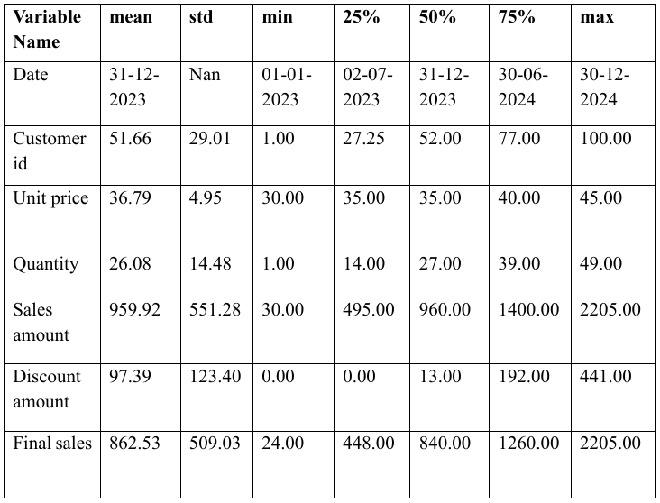
  DATASET DESCRIPTION
This dataset contains coffee sales data over 2 years in Saudi Arabia, covering purchases from 100 customers across 5 different coffee bean types.
(https://www.kaggle.com/datasets/halaturkialotaibi/coffee-bean-sales-dataset/data)
Some key points:
  Unit price remains quite consistent.
  Sales variation is primarily driven by order quantity and product mix.
  Peak sales values reflect bulk purchases and seasonal demand.
  Customer behavior suggests that discounts are more effective when targeted.
  There were high-value orders that did not use discount.
03

Slide 5
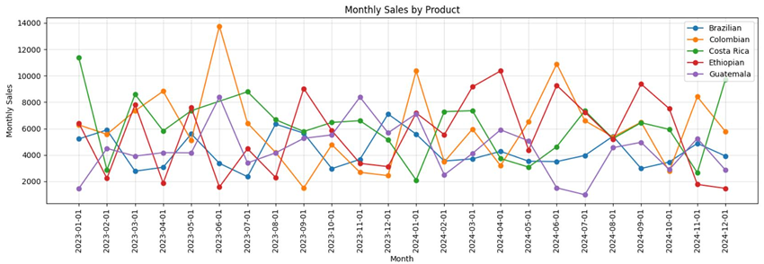
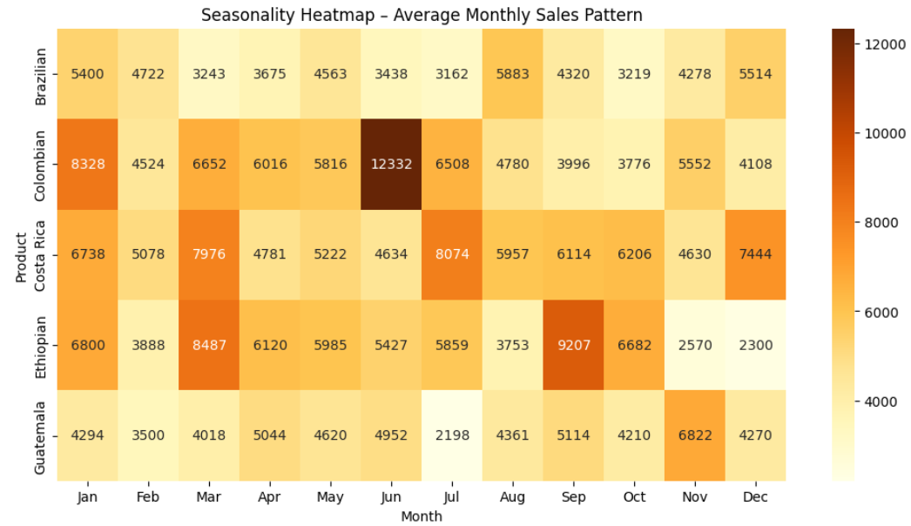
  SALES TREND ANALYSIS
Key Insights:
  Sales exhibit strong month-to-month volatility across all SKUs.
  No single SKU consistently dominates sales, depicting a diverse sales portfolio.
  Multiple SKUs show higher sales between March–July, but not in the same months.
  The darker regions in heatmap show the surge in demand for each SKU.
  The rotating peaks of the varieties indicate continuous but highly volatile demand throughout the year.
  The volatility of demand makes using forecasting techniques difficult.
04

Slide 6

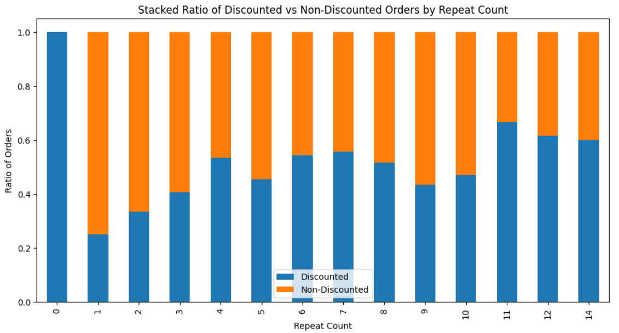
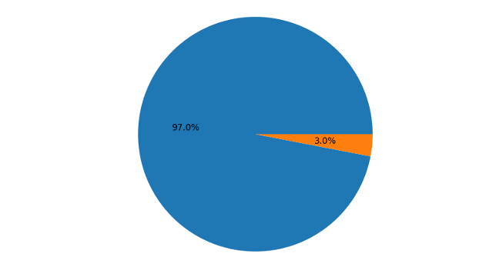
  DISCOUNT IMPACT ON CUSTOMER LOYALTY
  97% of all the customers having used discount at least once shows clear development of customer interest through promotions.
  Early repeat customers (less than 5 orders) are the most discount-dependent.
REPEAT CUSTOMERS THAT USED DISCOUNT AT LEAST ONCE
  Discount reliance decreases as repeat count increases.
  Customers with very high repeat counts still place a substantial share of non-discounted orders.
  Discounts appear effective for onboarding and early retention but are not required to sustain long-term customer loyalty.
05

Slide 7
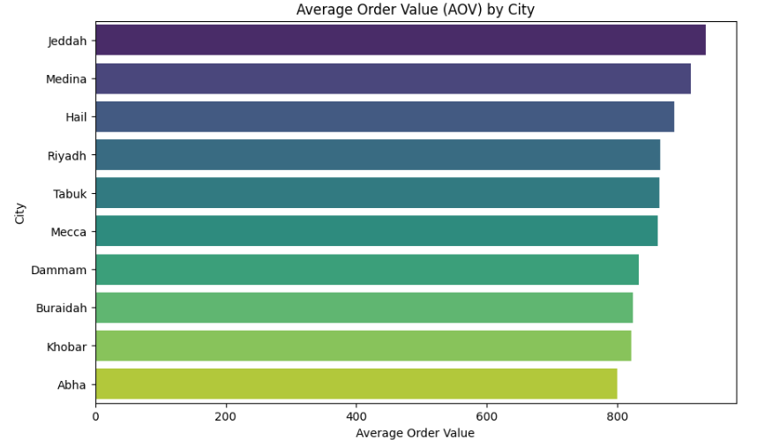
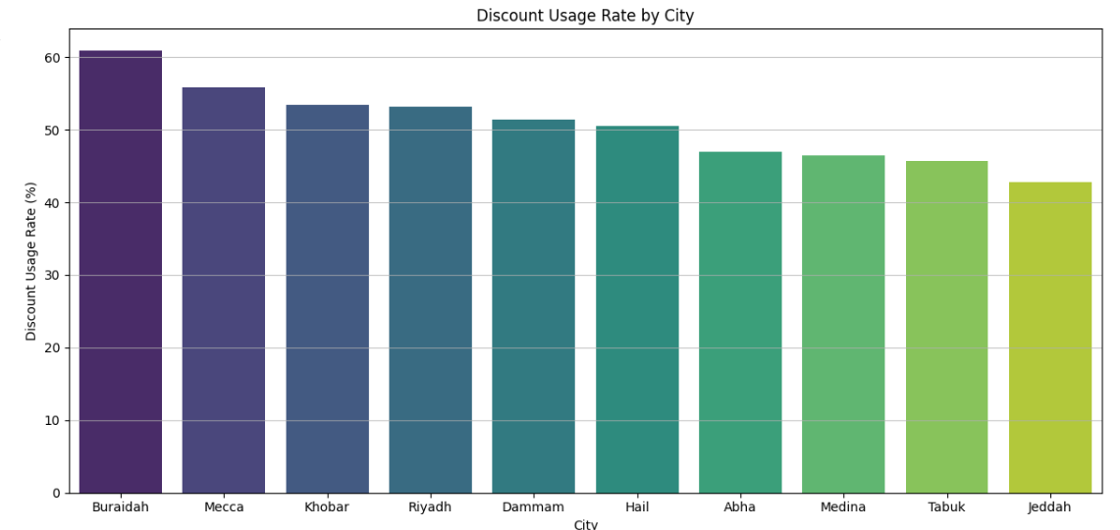
  CITY LEVEL ANALYSIS
7.1. IMPACT OF DISCOUNT ON AOV
  High AOV does not imply high discount dependence, Jeddah and Medina have the highest AOVs, yet they show lower discount usage rates.
  Discount-heavy cities do not achieve the highest order values, Buraidah has the highest discount usage rate, but its AOV is not among the top.
  Cities with lower AOVs (e.g., Abha, Buraidah) show higher discount usage, indicating greater sensitivity to promotions.
  Cities like Riyadh, Khobar, and Dammam display moderate AOV and moderate discount usage they likely respond to selective or targeted discounts rather than aggressive pricing.
06

Slide 8
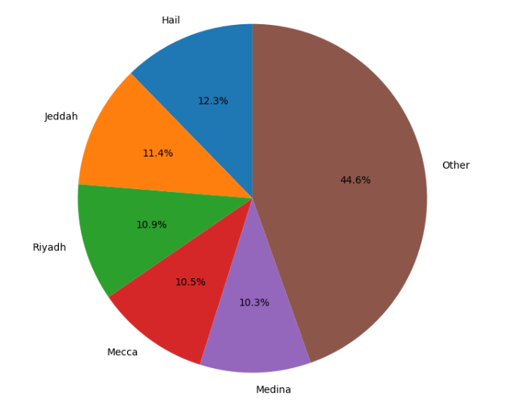
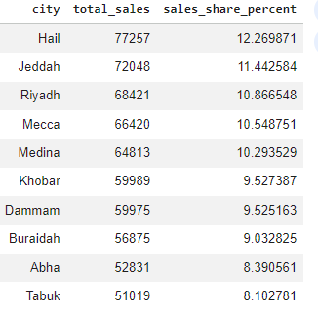
7.2. REVENUE SHARE ANALYSIS
  Revenue is moderately concentrated, not dominated by a single city, indicating a fairly distributed revenue base.
  Cities like Medina, Khobar, Dammam, and Buraidah each contribute around 9–10%, suggesting stable but competitive regional performance.
  Hail, Jeddah, Riyadh, and Mecca together account for over 45% of total sales.
  Lower-tier cities like Abha and Tabuk still contribute meaningfully and justify continued market presence.
  Revenue distribution supports a diversified market strategy
07

Slide 9

  RECOMMENDATIONS
  Inventory Strategy:
  A 4–6 week rolling forecast window, can be implemented for an estimate of demand.
  Trigger replenishment when sales exceed the rolling average by >20%, or stock falls below 1.5× the recent weekly sales.
  Keeping a safety stock to avoid risk of stock out:
  Customer Strategy:
  Segment customers by order count:
- Orders 1–2 → onboarding discounts (strong incentives)
- Orders 3–5 → lighter, conditional discounts
- 6+ orders → remove automatic discounts
  Pricing Strategy:
  Identify top-selling SKUs per city and stock them preferentially.
  Reduce slow-moving SKUs in cities where they do not peak.
  Set maximum discount limits by city:
  High-AOV cities → low or capped discounts
  Low-AOV cities → flexible, promotional discounts
  Review discount usage monthly at city level.
z: Service level factor(Often stock runout).
σ: Demand variability(std of demand).
L: Lead Time(replenishment time).
08

Slide 10
THANK YOU
9

